Slide 1
Empowered Learning
Explore the web, safely

Slide 2
Stay safe online…
Know how to stay safe when using the internet.
Know how to use your iPad safely.

Slide 3
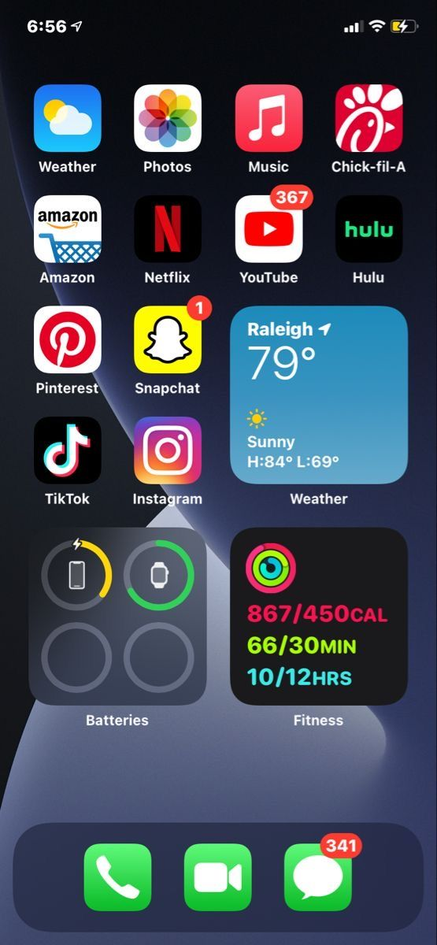
Most Popular Apps
TikTok
Snapchat
KiK
Messenger
Instagram

Slide 4
TikTok
TikTok is only for users aged 13 and over, and it actively removes underage accounts. You can report underage users in app, by emailing privacy@tiktok.com or completing an online form tiktok.com/legal/report/privacy
Accounts for users under 16 are set to Private by Default. Only someone the user approves can view or comment on their videos, they cannot Direct Message, their accounts are not suggested to others, and their videos cannot be downloaded.

Slide 5
TikTok
Accounts for users 16-17 have access to a wider range of features, such as Direct Messaging, Livestream, Duet and Stitch. For 16-17s these features have enhanced privacy settings, with many set to ‘Off’ by default unless the user actively decides to enable it.
Set your video to private: If you’ve already uploaded the video: Tap the three dots, tap Privacy settings and select Only me. If you’re about to post a video you can choose who can watch it: Only me, Friends or Everyone and you can choose whether comments are allowed.

Slide 6
TikTok
Choosing to make your account private allows you to approve or deny followers and restrict your uploaded content to followers only. To make your account private:
Tap on the profile tab
Go to the three-dot menu in the top-right corner
Tap on Privacy
Then toggle Private account
Keep your identity secure by not including any personal information, such as name, address, phone number or age in your profile.

Slide 7
Snapchat
Make sure to set your account to Private.
Remember: although the image you send disappears, nothing is ever fully deleted from the internet.
Never send a picture or message you will regret.

Slide 8
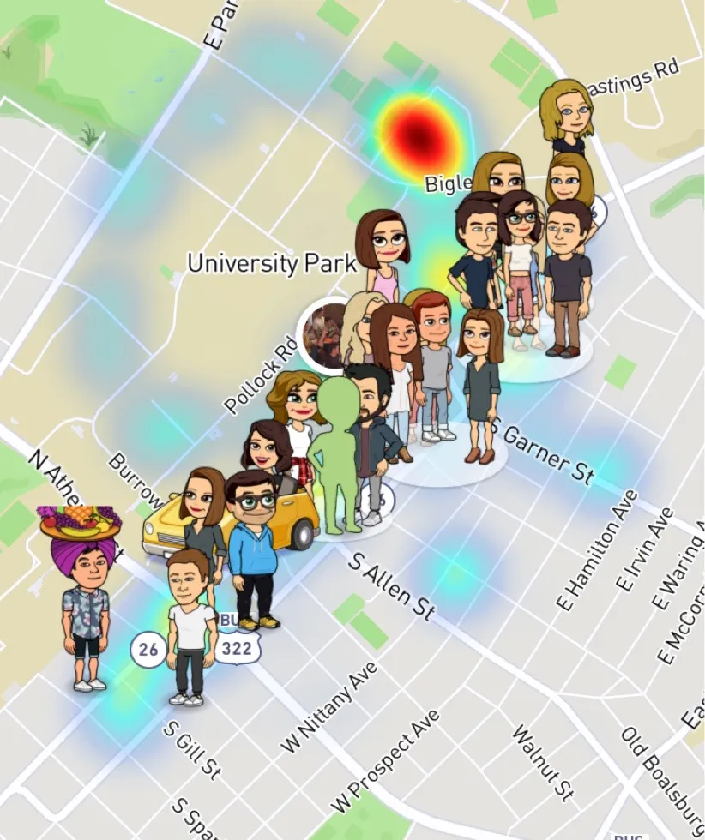
Snapchat – Snapmaps
This is a feature in which people can see your location.
It is extremely dangerous.
Turn this off by going to Settings > Ghost Mode. Turn this on so people cannot see your location.
Think about: who could be watching you?

Slide 9
KiK
KiK is a messenger app that allows people to talk to each other.
It allows chatting with random strangers which can be very dangerous.
There are no security measures in place and no form of privacy policy.
This makes it easy for people to pretend to be someone they are not.

Slide 10
Messenger
Like KiK, it’s easy to set up accounts on Messenger, despite additional security measures.
People can pretend to be anyone.
Make sure your account is Private, or else anyone will be able to message you.

Slide 11
Instagram
Instagram accounts should always be set to Private. This limits your photos to your followers.
NEVER click on links sent to you by accounts you don’t recognise.
These can be viruses or attempts to steal your account information.

Slide 12
STAY SAFE
Never share your name, age, phone number, address, or even your school.
Never send any pictures to a stranger.
Keep passwords private - don’t share even with your pals.
Never open an email from someone you don’t recognise. It may contain a virus that will totally shut down your computer OR let someone use your computer without your knowing it.
Only visit age-appropriate sites.
If you see something that makes you feel uncomfortable, tell an adult you trust.

